Slide 1
Comparative Abundance of Reef Sharks in the Western Indian Ocean
Chris Clarke^{1,2}, James Lea^{1,3} and Rupert Ormond^{4,5}
¹Danah Divers, Marine Research Facility, PO Box 10646, Jeddah, 21443, Saudi Arabia.
²University Marine Biological Station, Millport, Isle of Cumbrae, Ayrshire, Scotland KA28 0EG, UK
³University of Plymouth, Drake Circus, Plymouth, Devon, PL4 8AA, UK
⁴Marine Conservation International, South Queensferry, Edinburgh, Scotland, EH30 9WN, UK
⁵Centre for Marine Biodiversity & Biotechnology, Heriot-Watt University, Edinburgh, EH14 4AS, UK

Slide 2
Introduction
Global concern decline in shark populations (Baum & Myers, 2004; Clarke et al. 2006; Ferretti et al. 2008)
Besides threat to shark biodiversity, evidence predator loss may alter community structure and disrupt ecosystem services (Ferretti et al. 2010).
In Indian Ocean available fisheries data suggest similar biomass decline, delayed by the later industrialisation of fisheries (Tremblay-Boyer, 2011)
  Seychelles plateau several periods intensive shark exploitation, various species increasingly scarce (Nevill et al. 2007)
  Maldives shark landings increase to point where considered overexploited (Anderson & Ahmed 1993; Martin & Hakeem, 2006), and in March 2010 all shark fishing and product export banned (MRC, 2009).
  Chagos Archipelago poaching and bycatch in tuna fishery resulted decline sharks seen per dive by >90% (Graham et al. 2010; Sheppard et al. 2012).
  Saudi Rea Sea steep decline numbers grey reef and silky sharks attending baited study sites appears due shark fishing (Clarke et al., in press)

Slide 3
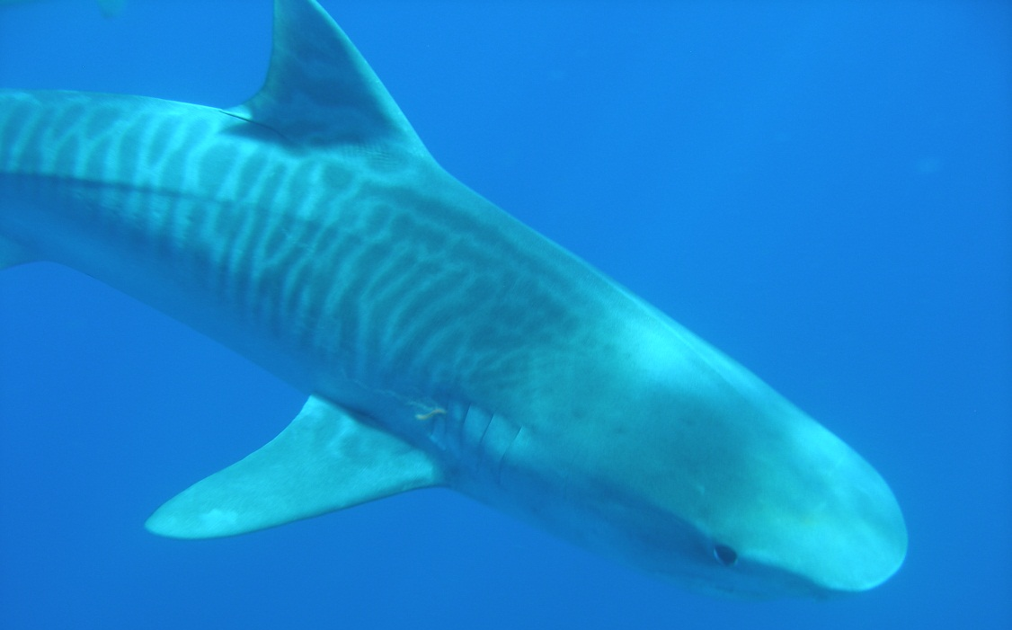
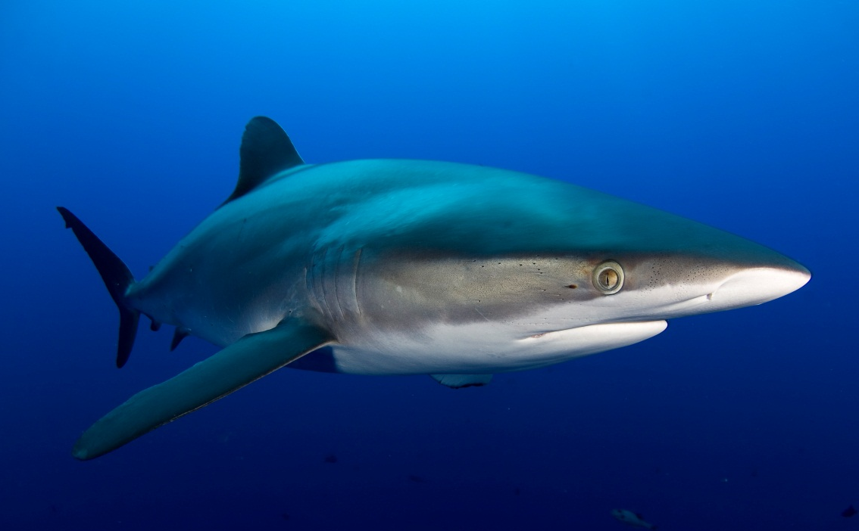
Objectives
Assess current abundance of sharks at series locations possibly subject different levels exploitation.
Look for any evidence of ecosystem level effects due loss of top predators
Determine if relatively pristine populations of especially largest sharks (Tiger, Oceanic-white-tip, Silky & Bull sharks) present at any of most remote locations.

Slide 4
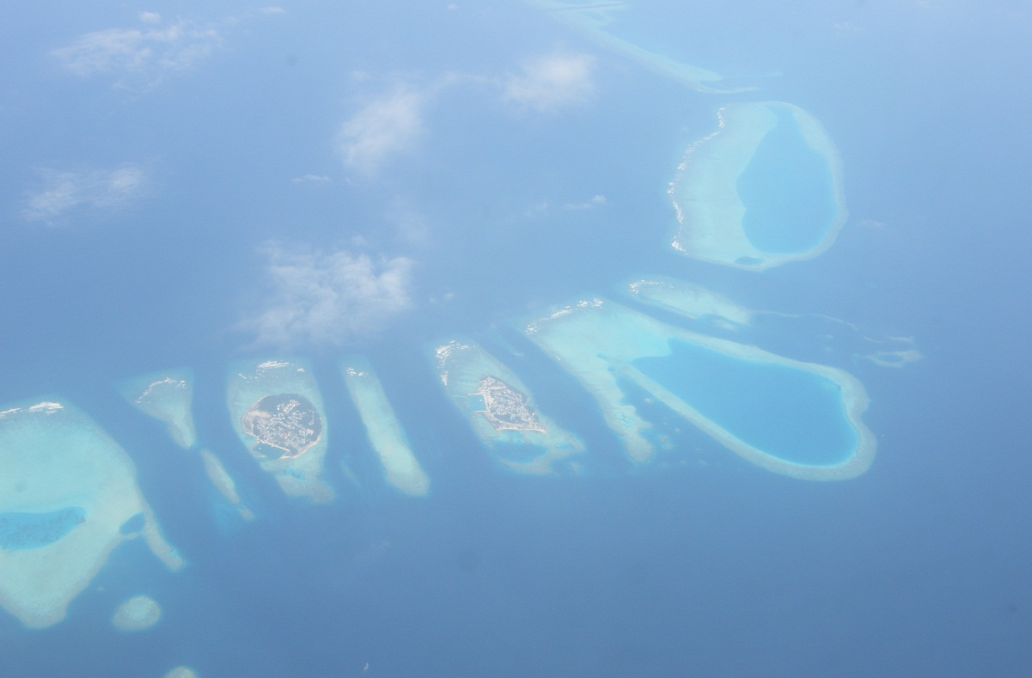
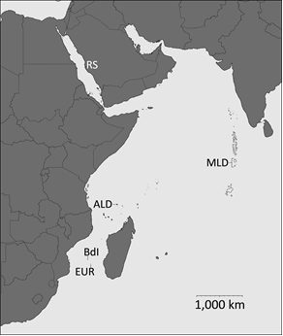
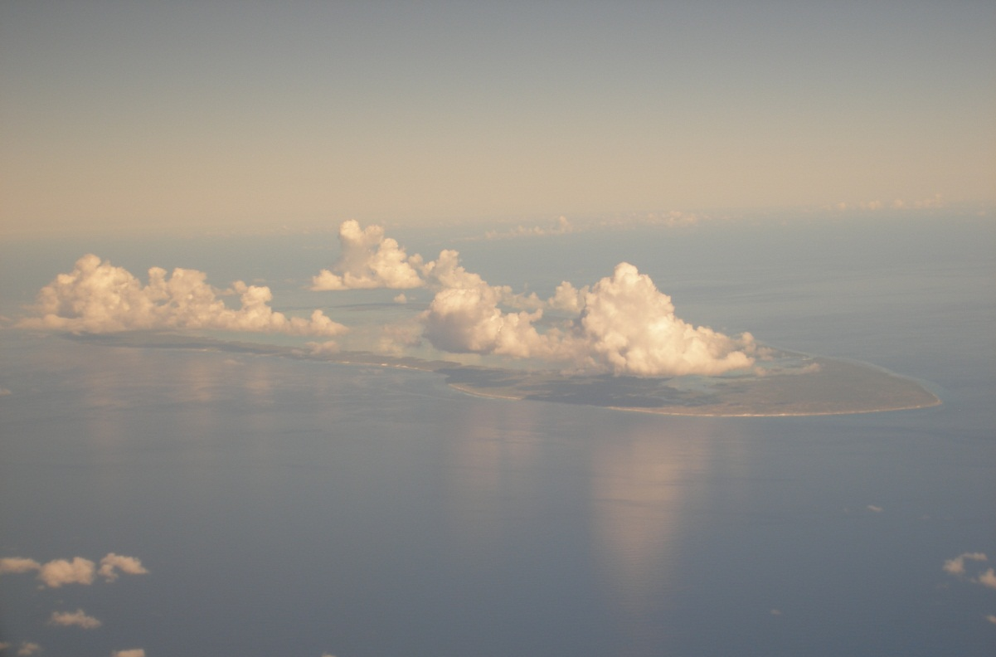
Study Areas
Red Sea (RS) Jeddah area
Saudi Arabia
Southern Maldives (MLD)
Aldabra (ALD), Seychelles
Bassas da India (BdI)
Europa (EUR)
(French Îles Éparses)

Slide 5
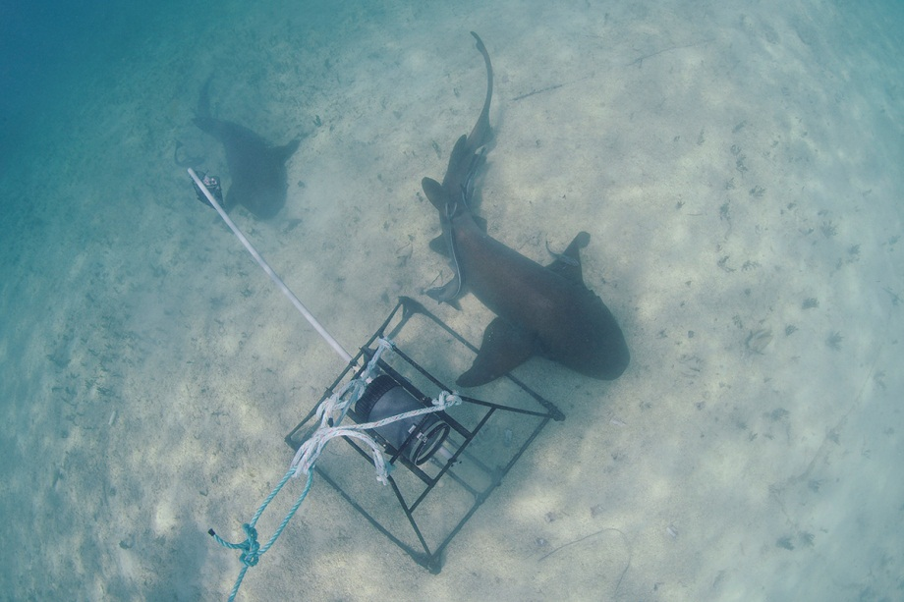
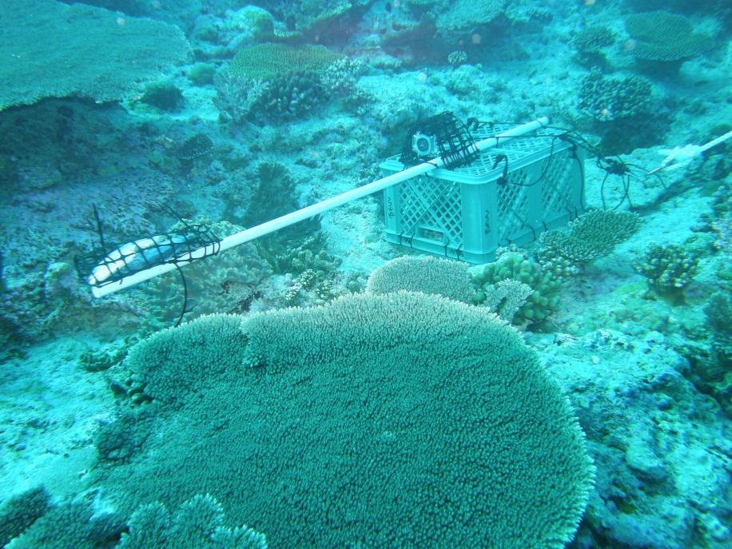
Methods
Surveys, mostly one off, over 4 year period
Baited Remote Underwater Video (BRUVS) - 100 mins
standard metal pyramidal frame
sand-filled plastic crate
Diver Baited Underwater Visual Census (DBUVC) - 50 mins
perforated drum with tuna & chum
stationary
drifting
Results standardised to catch per unit hour (of observation)

Slide 6
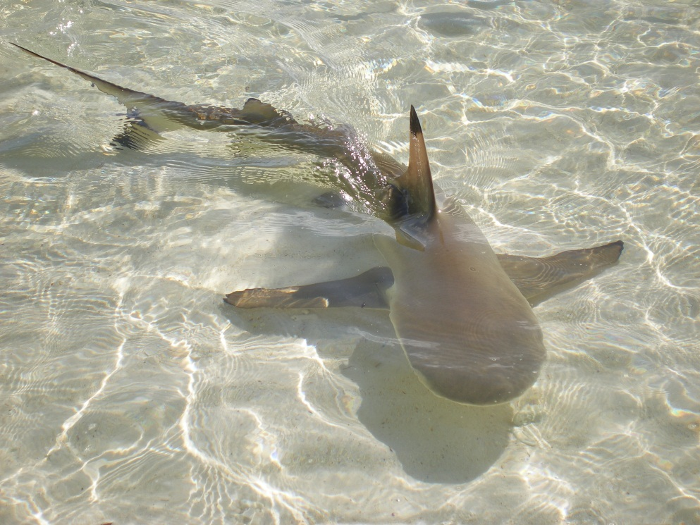
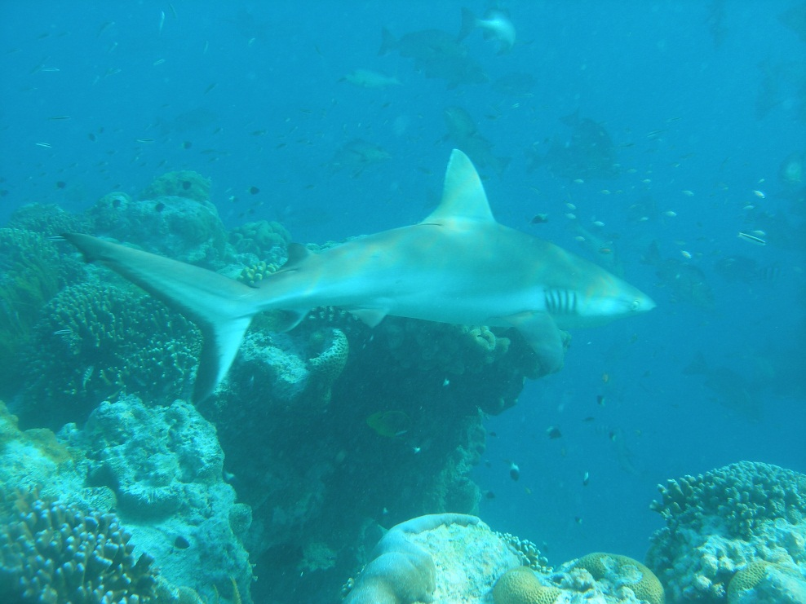
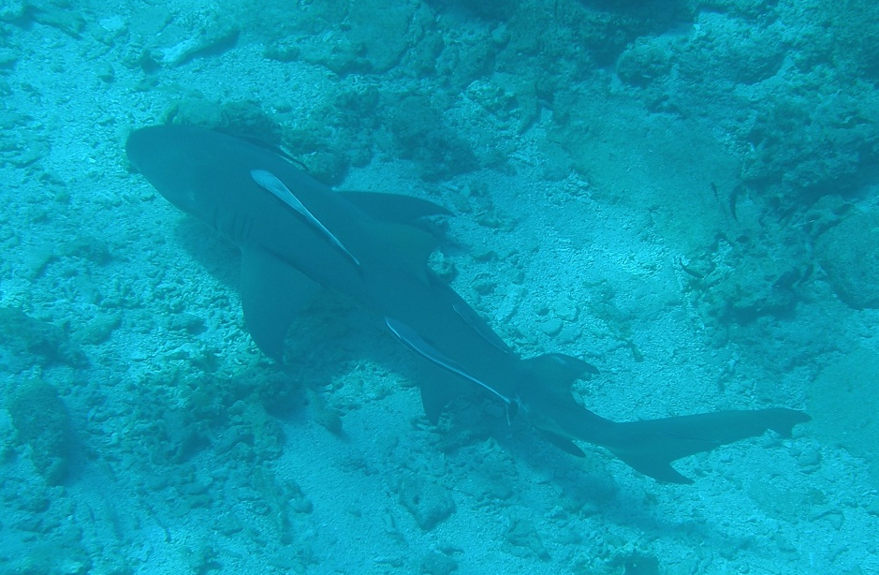
White-tip reef shark
Black-tip reef shark
Grey reef shark
Sickle-fin lemon shark

Slide 7
Results
254 survey hours, 795 sharks, 11 species.
Mean
Number
Sharks
Per Hour
Study Areas
Sharks Species

Slide 8
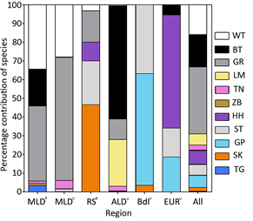
Community Composition
White-tip reef shark
Black-tip reef shark
Grey reef shark
Sickle-fin lemon shark
Tawny nurse shark
Zebra shark
Hammerhead spp.
Silver-tip shark
Galapagos shark
Silky shark
Tiger shark
Maldives (BRUVS) Saudi Red Sea Bassas d’India Combined Data
Maldives (UVS) Aldabra Europa

Slide 9
Statistical
Analysis (GLM)
Species | R² | Factor | d.f. | F | p
White-tip reef | 50.5 | Region | 4 | 22.18 | <0.001
 |  | Habitat | 7 | 2.39 | 0.023
 |  | Method | 1 | 107.97 | <0.001
Grey reef | 38.28 | Region | 4 | 6.81 | <0.001
 |  | Habitat | 7 | 11.26 | <0.001
 |  | Method | 1 | 26.59 | <0.001
Black-tip reef | 77.7 | Region | 4 | 108.85 | <0.001
 |  | Habitat | 7 | 22.65 | <0.001
 |  | Method | 1 | 1.70 | 0.194
Sickle-fin lemon | 63.68 | Region | 4 | 54.55 | <0.001
 |  | Habitat | 7 | 10.27 | <0.001
 |  | Method | 1 | 0.00 | 1.000
Tawny nurse | 2.52 | Region | 4 | 1.13 | 0.344
 |  | Habitat | 7 | 0.89 | 0.518
 |  | Method | 1 | 5.48 | 0.020
Galapagos | 36.28 | Region | 4 | 16.6 | <0.001
 |  | Habitat | 7 | 6.18 | <0.001
 |  | Method | 1 | 0.00 | 1.000
Silky | 58.86 | Region | 4 | 50.45 | <0.001
 |  | Habitat | 7 | 20.32 | <0.001
 |  | Method | 1 | 0.00 | 1.000
Tiger | 0.00 | Region | 4 | 0.31 | 0.869
 |  | Habitat | 7 | 0.55 | 0.793
 |  | Method | 1 | 3.99 | 0.047
Zebra | 0.00 | Region | 4 | 0.15 | 0.961
 |  | Habitat | 7 | 0.72 | 0.657
 |  | Method | 1 | 2.12 | 0.147
Hammerhead | 16.11 | Region | 4 | 9.89 | <0.001
 |  | Habitat | 7 | 0.39 | 0.910
 |  | Method | 1 | 0.04 | 0.834
Silver-tip | 42.75 | Region | 4 | 14.75 | <0.001
 |  | Habitat | 7 | 10.01 | <0.001
 |  | Method | 1 | 1.36 | 0.245
REGION
Most spp. showed effect -
all except Tawny nurse,
Tiger and Zebra shark
HABITAT
Lagoon, Patch Reef, Channel,
Outer Reef, Seamount
About half of spp. showed
effect incl: Grey and Black-tip
reef sharks, Sickle-fin lemon
& Galapagos sharks
METHOD
2 spp. showed significant effect:
White-tip reef and Grey reef

Slide 10
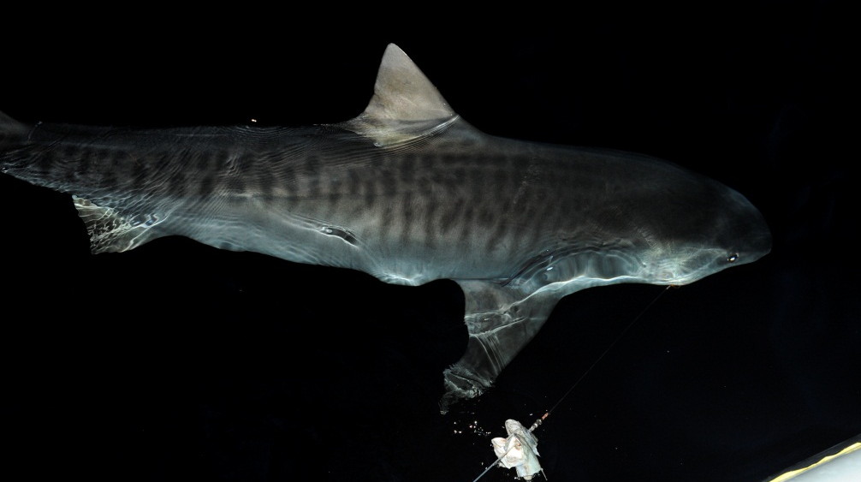
Discussion
Overall means varied by factor of two, highest in southern Maldives, lowest at Bassas da India – nowhere were large sharks abundant
Higher values comparable to Sudanese Red Sea (Hussey, 2011) or Chagos in 1970s; greater than most recent values globally.
Results for some spp. depend on method: visual surveys especially detect better sharks with tendency to school - Grey reef and Scalloped hammerhead sharks - also white-tip reef sharks.
BRUVs appeared more likely to detect cautious or cryptic species - Tiger & Zebra sharks – former also by fishing at night.

Slide 11
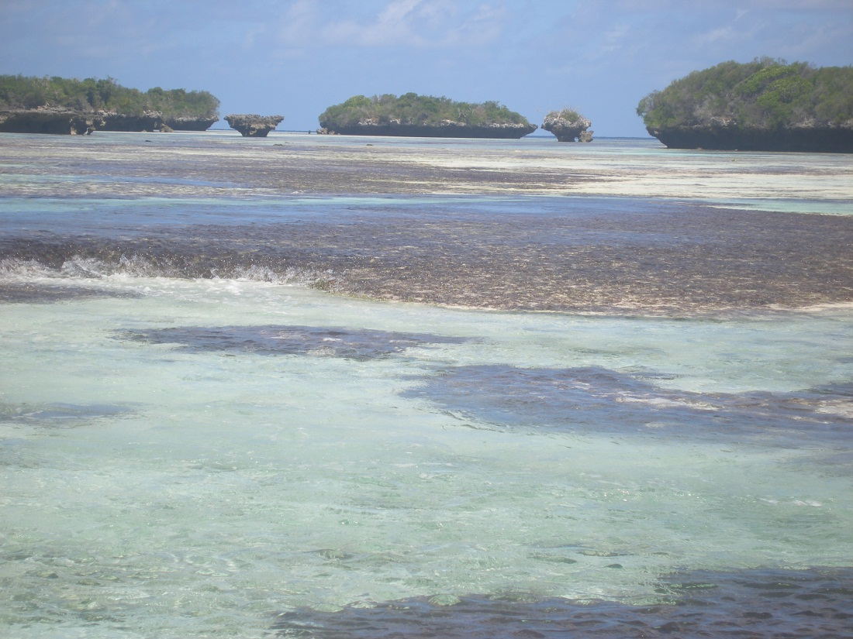
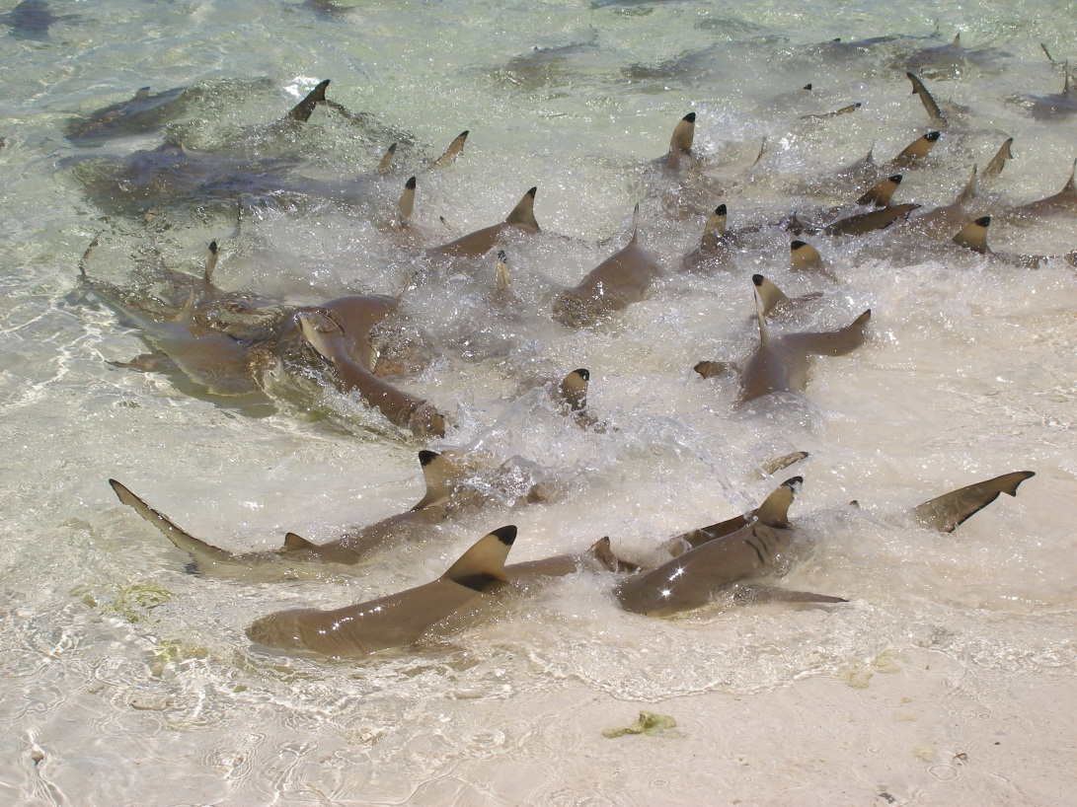
Discussion
Considerable differences in which most abundant species in different region / study areas.
Appear very likely related to extent of different habitat e.g. shallow lagoon favours Black-tip reef sharks & juvenile Galapagos, narrow channels Sickle-fin lemon sharks, deep wide channels Grey reef sharks;
Ability avoid competition or predation due larger species may be critical.

Slide 12
Discussion
Difficult to relate to fishing pressure, abundance of large teleosts, or health of coral community, save Southern Maldives had healthiest coral assemblage and highest shark diversity
Fishing pressure on sharks also difficult to assess; but clear even most remote regions have been subject to considerable exploitation in recent and more distant past:
  Aldabra heavily exploited for turtles & fish prior to becoming World Heritage Site, and reef only protected to I km from shore, so outer fore-reef may be subject to long-lining etc.
  Seychelles generally subject to fairly intense commercial shark fishing during early and mid 20th century.
  Southern Maldives now seems most remote part of Maldives, but was first area to experience development due Airforce base on Adu Atoll.
  Chagos been subject considerable targeted and incidental catch of sharks through long-lining, much of it illegal.

Slide 13
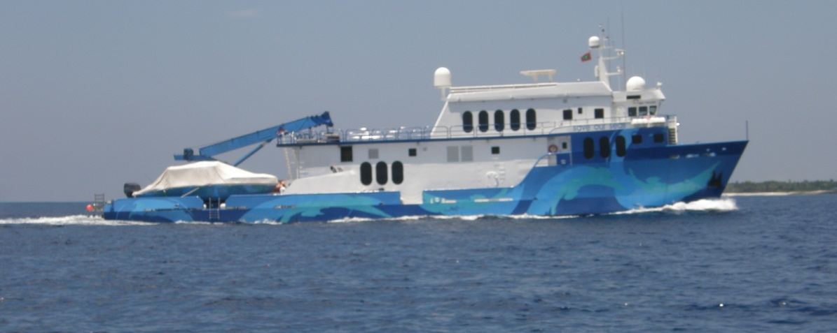
Discussion
Largest species – Tiger, Oceanic white-tip, scarce in all regions, only encountered in selected areas.
Largest sharks e.g. Tigers range over large areas , so not protected by MPAs or remoteness.
Thanks due to field staff of Danah divers (Jeddah) and to crew of research vessel M.Y Danah Explorer for assistance with fieldwork. Thanks also due to government authorities and agencies in each study area, for approval and logistical support.

Slide 15
 | Region | MLD^{U} | MLD^{B} | RS^{B} | ALD^{U} | BdI^{U} | EUR^{U}
 | Hours | 35.33 | 144.00 | 19.72 | 28.25 | 11.47 | 15.28
WT | Σ | 95 | 30 | 1 | 1 | - | -
 | Mean | 2.69 | 0.21 | 0.05 | 0.04 | - | -
 | SD | 4.92 | 0.32 | 0.22 | 0.20 | - | -
BT | Σ | 1 | 17 | - | 115 | - | 5
 | Mean | 0.03 | 0.12 | - | 4.07 | - | 0.33
 | SD | 0.14 | 0.26 | - | 4.48 | - | 0.58
GR | Σ | 223 | 35 | 5 | 21 | - | -
 | Mean | 6.31 | 0.24 | 0.25 | 0.74 | - | -
 | SD | 23.76 | 0.79 | 0.37 | 1.38 | - | -
TN | Σ | 15 | 1 | - | 5 | - | -
 | Mean | 0.42 | 0.01 | - | 0.18 | - | -
 | SD | 2.38 | 0.06 | - | 0.55 | - | -
LM | Σ | - | - | - | 47 | - | -
 | Mean | - | - | - | 1.66 | - | -
 | SD | - | - | - | 2.13 | - | -
TG | Σ | - | 3 | - | - | - | -
 | Mean | - | 0.02 | - | - | - | -
 | SD | - | 0.10 | - | - | - | -
ZB | Σ | - | 1 | - | - | - | -
 | Mean | - | 0.01 | - | - | - | -
 | SD | - | 0.06 | - | - | - | -
GP | Σ | - | - | - | - | 34 | 17
 | Mean | - | - | - | - | 2.97 | 1.11
 | SD | - | - | - | - | 5.50 | 2.78
ST | Σ | 5 | - | 7 | - | 21 | 14
 | Mean | 0.14 | - | 0.36 | - | 1.83 | 0.92
 | SD | 0.76 | - | 0.57 | - | 2.23 | 2.74
HH | Σ | 1 | - | 3 | 1 | - | 55
 | Mean | 0.03 | - | 0.15 | 0.04 | - | 3.60
 | SD | 0.15 | - | 0.23 | 0.59 | - | 9.16
SK | Σ | - | - | 14 | - | 2 | -
 | Mean | - | - | 0.71 | - | 0.17 | -
 | SD | - | - | 0.79 | - | 0.41 | -
All | Σ | 340 | 87 | 30 | 190 | 57 | 91
 | Mean | 9.62 | 0.60 | 1.52 | 6.73 | 4.97 | 5.95
 | SD | 22.46 | 0.88 | 1.61 | 5.28 | 5.19 | 10.94

